Slide 1




Input | Method
(a)
 | GUMI-AE | generated | ウォーリーを探せ
 |  | translated | Where’s Wally
 | NJM | generated | 鍋にオタマジャクシが入っていた
 |  | translated | There were tadpoles in the pot
(b)
 | GUMI-AE | generated | チャックが開いてるよぉ
 |  | translated | Your zipper is open
 | NJM | generated | 海が割れるのよ
 |  | translated | The sea will split
(c)
 | GUMI-AE | generated | 今からこのマイクを鼻に入れます
 |  | translated | Now, I’m going to put this microphone up my nose
 | NJM | generated | 奥さんに浮気がバレた
 |  | translated | His wife caught him cheating on her.
(d)
 | GUMI-AE | generated | ママこれ買って
 |  | translated | Mom, buy this
 | NJM | generated | 100円落としたーーー
 |  | translated | I dropped 100 yen---

Slide 2
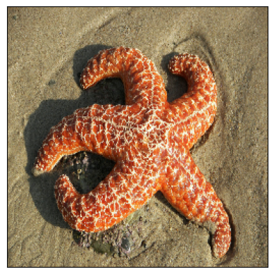
Input | Method
(a)
 | GUMI-AE | generated | ウォーリーを探せ
 |  | translated | Where’s Wally
 | NJM | generated | 鍋にオタマジャクシが入っていた
 |  | translated | There were tadpoles in the pot
(b)
 | GUMI-AE | generated | チャックが開いてるよぉ
 |  | translated | Your zipper is open
 | NJM | generated | 海が割れるのよ
 |  | translated | The sea will split
(c)
 | GUMI-AE | generated | ママこれ買って
 |  | translated | Mom, buy this
 | NJM | generated | 100円落としたーーー
 |  | translated | I dropped 100 yen---
(d)
 | GUMI-AE | generated | 最後の一発ギャグを披露
 |  | translated | Perform one last gag.
 | NJM | generated | 捕獲されたクラゲ
 |  | translated | Captured jellyfish.

Slide 3
Input | Method
(a)
 | GUMI-AE | generated | ウォーリーを探せ
 |  | translated | Where’s Wally.
 | NJM | generated | 鍋にオタマジャクシが入っていた
 |  | translated | There were tadpoles in the pot.
(b)
 | GUMI-AE | generated | チャックが開いてるよぉ
 |  | translated | Your zipper is open.
 | NJM | generated | 海が割れるのよ
 |  | translated | The sea will split.
(c)
 | GUMI-AE | generated | 今からこのマイクを鼻に入れます
 |  | translated | Now, I’m going to put this microphone up my nose.
 | NJM | generated | 奥さんに浮気がバレた
 |  | translated | His wife caught him cheating on her.
(d)
 | GUMI-AE | generated | 最後の一発ギャグを披露
 |  | translated | Perform one last gag.
 | NJM | generated | 捕獲されたクラゲ
 |  | translated | Captured jellyfish.

Slide 4
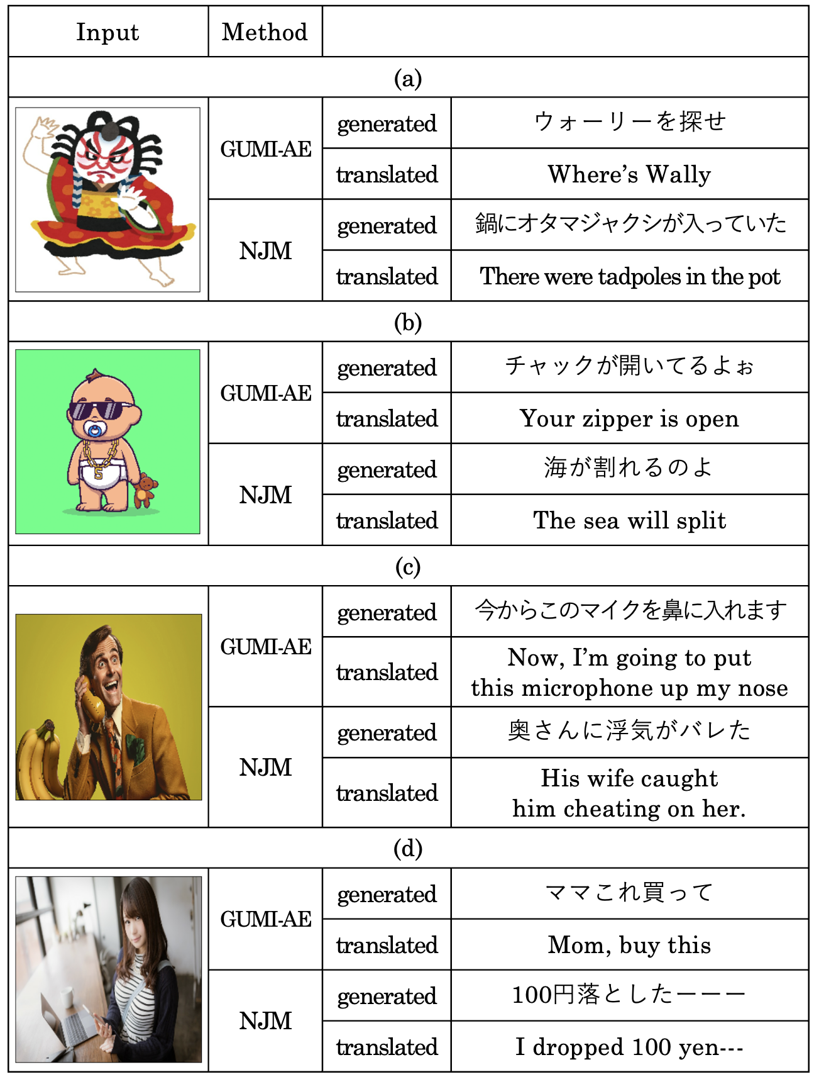

Slide 5
